Slide 1
The SMART Skateboard
Group 6

Slide 2
Project Group Members
Matias “Nick” Canter | nickcanter3@knights.ucf.edu | EE
Brandon Carty | bccarty218@knights.ucf.edu | EE
Jonathan Espinal | Espinal_j@knights.ucf.edu | EE
Taymas Musaev | tmusaev@knights.ucf.edu | CpE

Slide 3
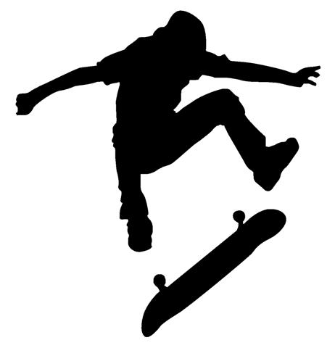
Project Introduction & Goals
Our main goal is to design a small electronic device that anyone can easily attach to the bottom of their skateboard.
This device will be linked to a mobile application. Ultimately, using the phone’s memory, the device will track and record past tricks the user performed.

Slide 4
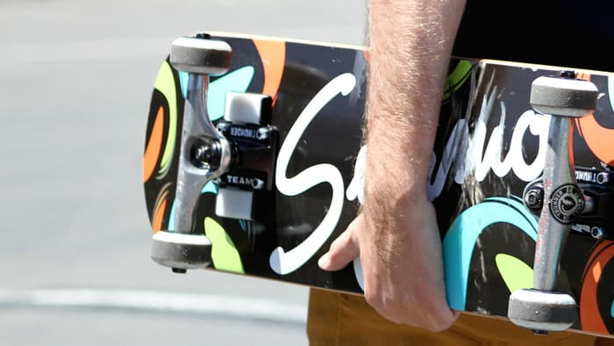
Motivation
There has yet to be a full tech revolution in the skateboarding industry.
In the past, skateboarders have had a hard time logging the tricks they landed, unless they had a cameraman nearby.
Some companies have tried, all have failed. (i.e. Syrmo)
Similar products were too intricate, creating increased costs leading to failure.
We wanted to have a design that could succeed where others have failed, while also fully testing our engineering capabilities.
Copyright:Syrmo

Slide 5
Basic Skateboarding Tricks Explained
180s - the board spins 180 degrees either frontside or backside
360s - the board spins 360 degrees either frontside or backside
Kickflip - board is manipulated by the feet during a jump so that it spins sideways through 360 degrees
Heelflip - front heel is used to manipulate the board during a jump in such a way that it completes a sideways rotation

Slide 6
SMART Skateboard Requirements
Device should have negligible weight to the user
Enough power to last for an entire skating session
Durable enough to withstand the impact endured from regular use
Accurate enough to detect slight differences in tricks
The mobile application should have a low latency and high range
The overall cost of the device must be reasonable.

Slide 7
SMART Skateboard Specifications
Component | Parameter | Design Specification
Entire Device | Total Weight | Under 32 ounces
Entire Device | Impact Resistance | 5 foot free-fall
Entire Device | Cost | Under $250
Battery | Lifetime | At least 5 hours
Motion Sensors | Accuracy | Within 10%
Wireless Sensors | Range | At least 6 feet
Software | Latency | Under 5 seconds
Notes:
Ideally aiming to keep the device under 250$
Range/latency
2000 mA hours

Slide 8
System Block Diagram
The microcontroller polls the motions sensors for their raw data.
A filter is applied to the raw data for accuracy.
The communication chip then transmits the yaw, roll, and pitch to a connected smart phone, wirelessly
The app interprets the data and decides which skateboarding tricks were performed

Slide 9
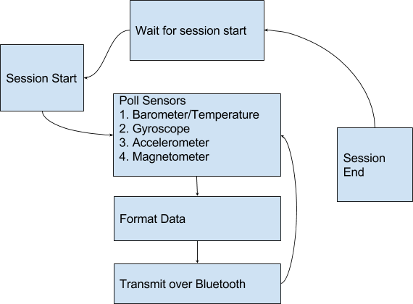
System Block Diagram
Embedded:

Slide 10
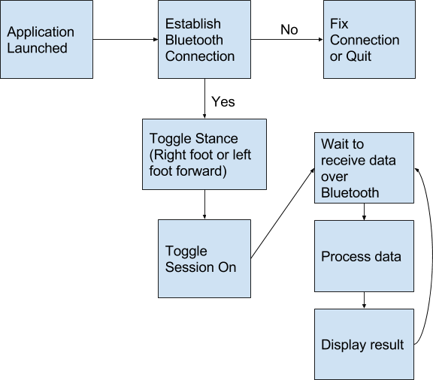
System Block Diagram
Mobile:

Slide 11
Approach/Implementation
The following covers major milestones achieved during the development process:
Test MCU for proper functionality
Configure BLE module along with the required sensors
Optimize the design of our SMART device
Integrated power source to ensure entire device can be mobilized
Confirmed orientation capabilities
Notes:
Ran a few tests on the microcontroller for proper functionality
Configure module/sensors & optimized our breadborad design
Ensured device can be mobilized & confirmed orientation capabilities

Slide 12
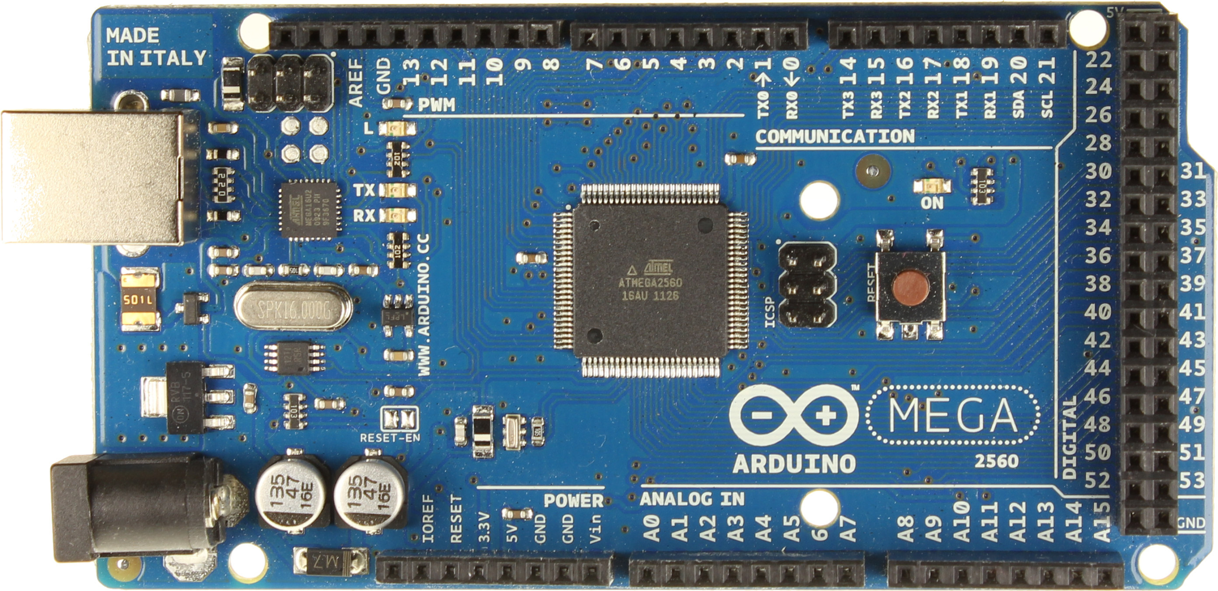
Arduino Mega (not selected)

Slide 13
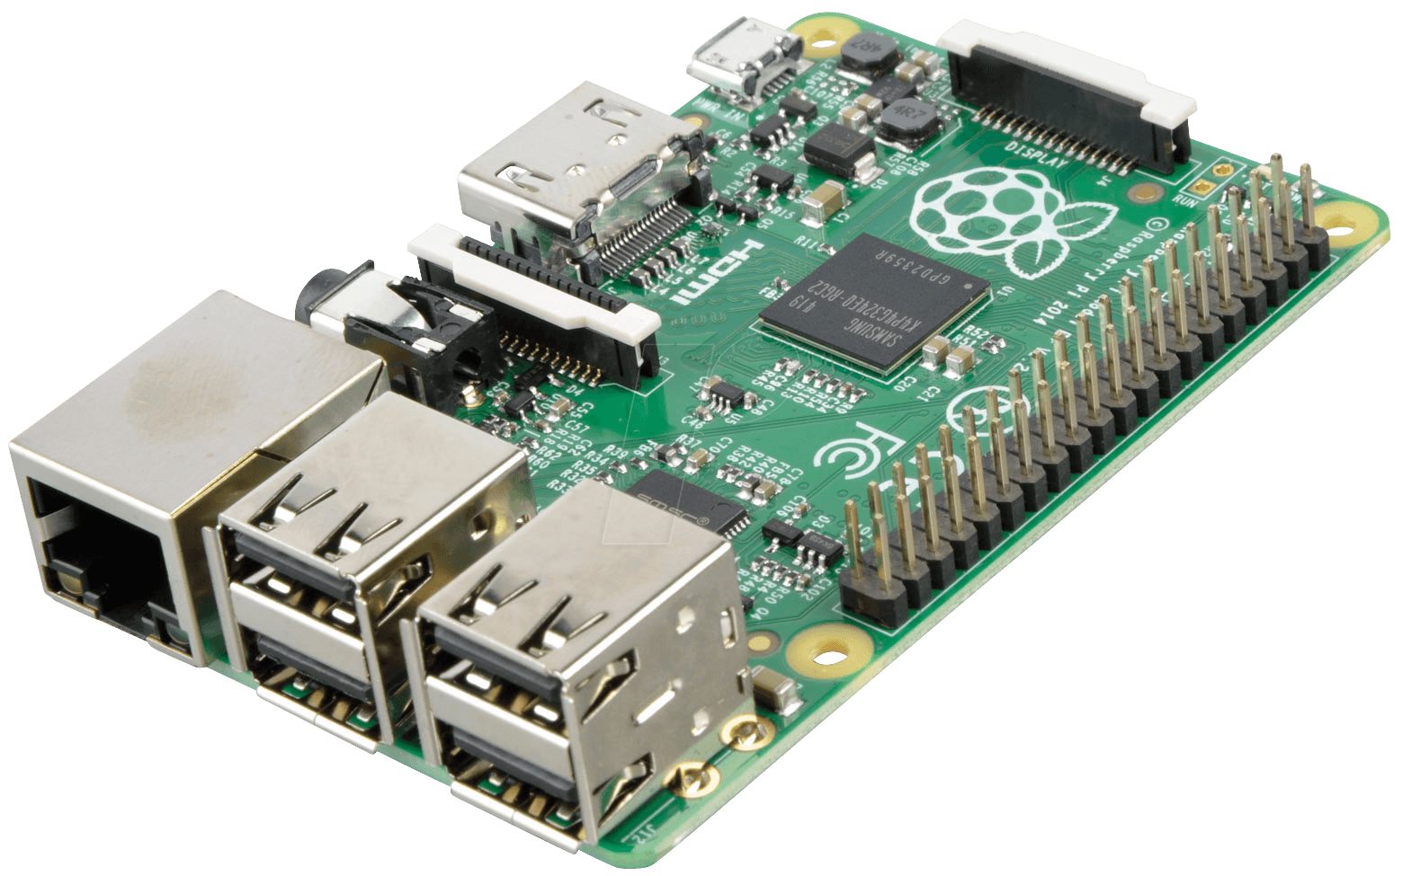
Raspberry Pi
(not selected)

Slide 14
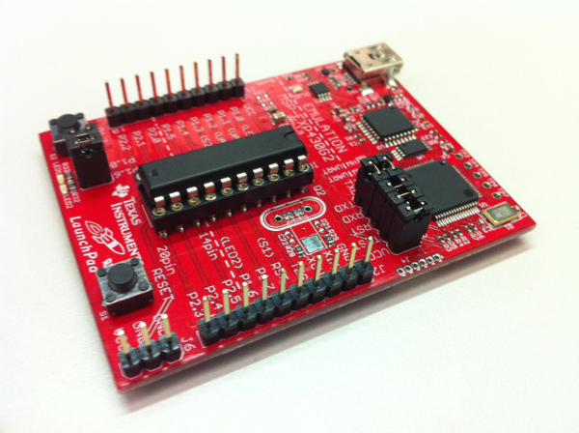
TI MSP430 (not selected)
Notes:
Open source community isn’t strong
Our CpE is a little more familiar with arduino

Slide 15
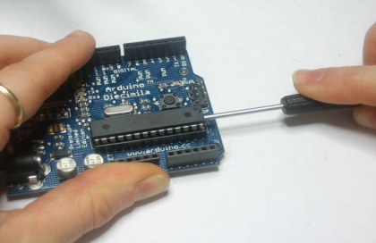
Arduino Uno (selected)
Notes:
Removable chip
etc.

Slide 16
Sensor Selection
Gyroscope | Features | Accelerometer | Function | Barometer | Function
LSM303 | Standby Mode Low Power Consumption 3 Axes of sensitivity | ADXL377 | Wide Range Measurement Easy Implementation | MPL225A1 | Low Power consumption Low latency
Maxim Integrated MAX21000 | Small in size No external Components needed Minimal delay | L3GD20H | Low Noise Wake on shake Feature | BMP180 | High Accuracy Factory calibrated
SparkFun MLX90609 Gyro Breakout Board | Low Zero rate Output drift On-chip calibration capability Wide operating temp range | ADXL362 | Minimal size Requirement Low Current Draw | N/A | N/A

Slide 17
Wireless Technology Selection
Technology | Selected? | Reason
Wi-Fi | NO | Long range unnecessary, high power consumption
Bluetooth LE | YES | Easy to integrate in software, low power consumption
VS
Notes:
create an easy wireless link between devices
Helps to minimize consumption rate

Slide 18
Power Supply Options and Selection
Option | Description | SMART Skateboard Impact
Switching, Unregulated, & Regulated converters and all other converters. | AC-DC converters that plug into the wall | A wall plug can only be beneficial for our design is terms of charging the device.
Alkaline/ Zinc Batteries | Typical battery seen in most convenience stores | Non-ideal voltage output. Non-rechargeable
Coin cell Lithium Batteries | Typical battery seen in digital watches | Non-ideal voltage output. Non-rechargeable
Lithium Polymer Batteries | Chemistry in most rechargeable batteries. Come in many different shapes | Many different voltage output options. Rechargeable. Possible impact damage.
Lithium Ion Batteries | Rechargeable batteries, that are less expensive than LiPo. | Many different voltage options. Rechargeable. Higher impact resistance.

Slide 19
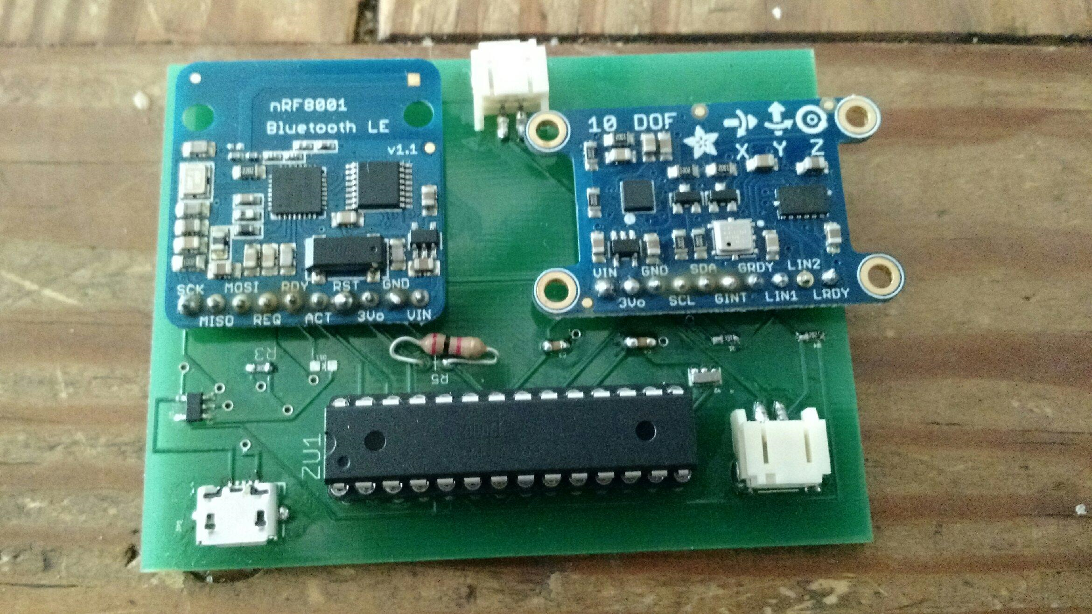
PCB Design/Schematics
The PCB design is the most imperative part of the project
Optimizing size and efficiency were priority
We initially breadboarded our design to run necessary tests:
Device recognition from mobile application
Functionality of the sensors via Bluetooth connection
Board positioning
The figure displays our finished PCB design with the required components

Slide 20
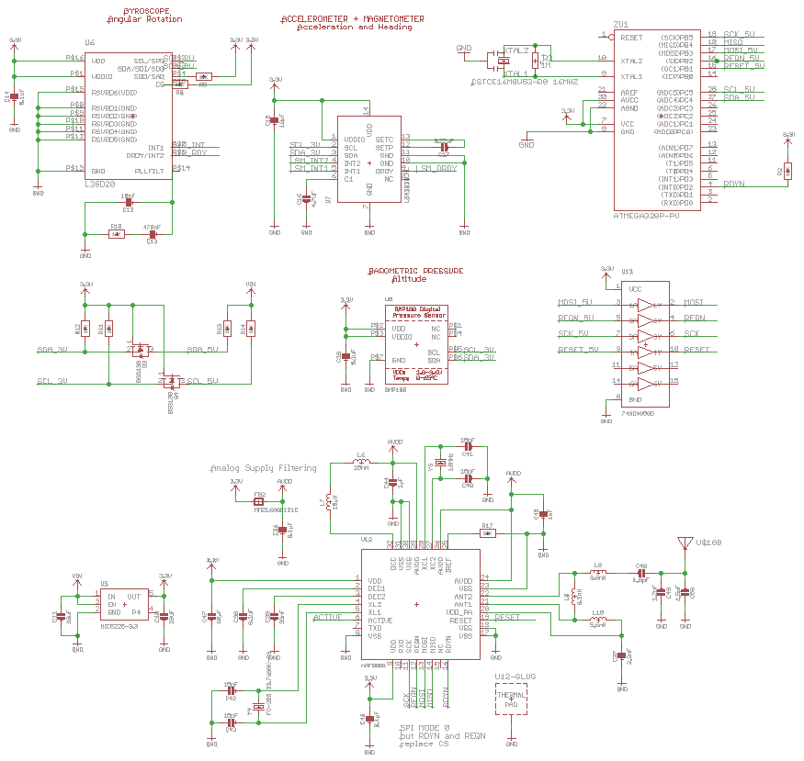
PCB Design/Schematics

Slide 21
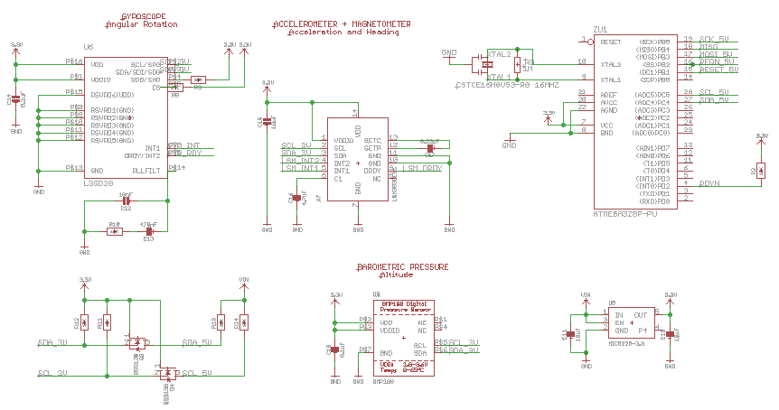
PCB Design/Schematics
Sensor Schematic

Slide 22
PCB Design/Schematics
Sensor Schematic

Slide 23
PCB Design/Schematics
Sensor Schematic

Slide 24
PCB Design/Schematics
Sensor Schematic

Slide 25
PCB Design/Schematics
Sensor Schematic

Slide 26
PCB Design/Schematics
Sensor Schematic
Notes:
level shifter is used to convert one voltage into another voltage

Slide 27
PCB Design/Schematics
Sensor Schematic
Notes:
voltage regulator is used to produce constant output voltage from high voltage

Slide 28
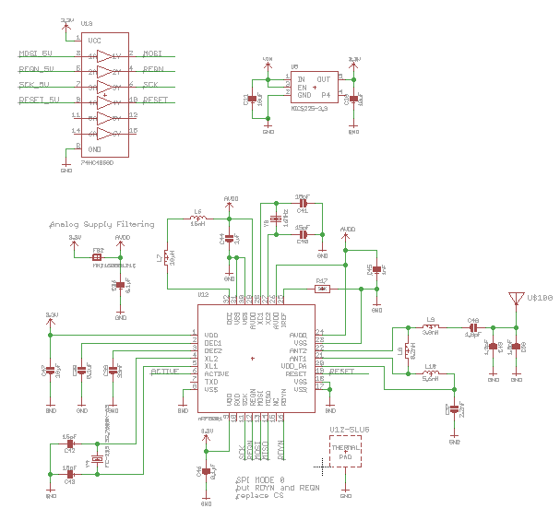
PCB Design/Schematics
Bluetooth Schematic

Slide 29
PCB Design/Schematics
Bluetooth Schematic

Slide 30
PCB Design/Schematics
Bluetooth Schematic

Slide 31
PCB Design/Schematics
Bluetooth Schematic

Slide 32
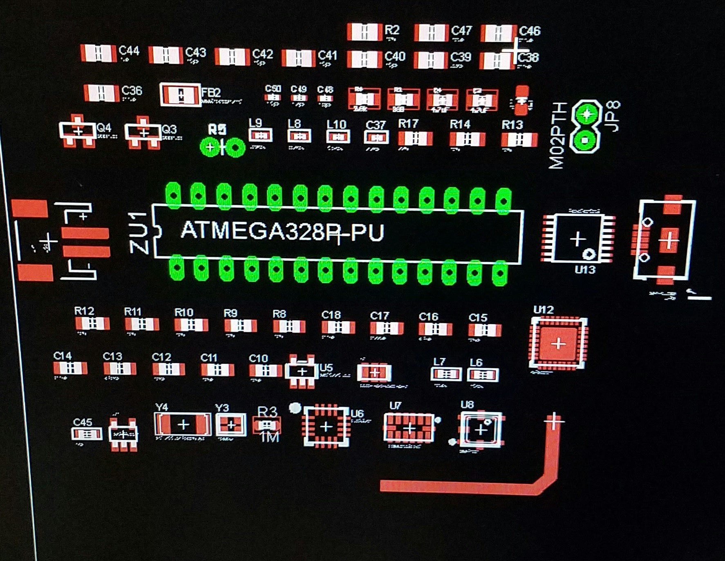
Initial Board design

Slide 33
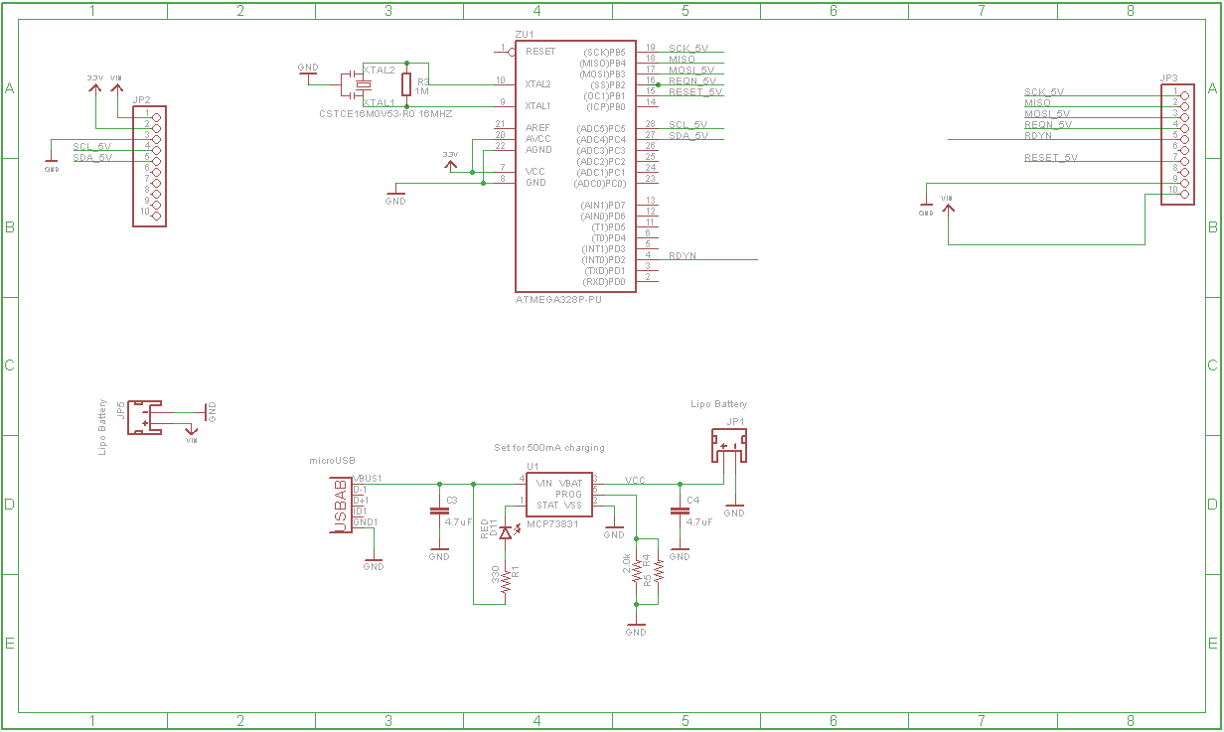
Final Schematic

Slide 34
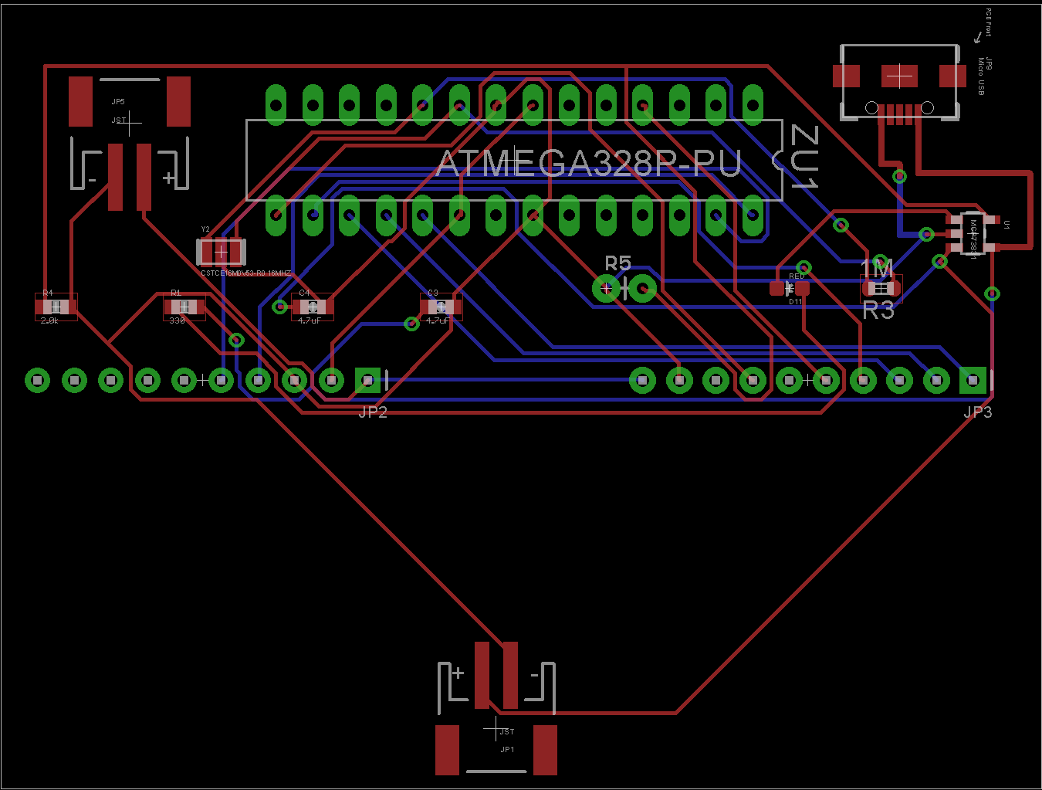
Final Board Design

Slide 35
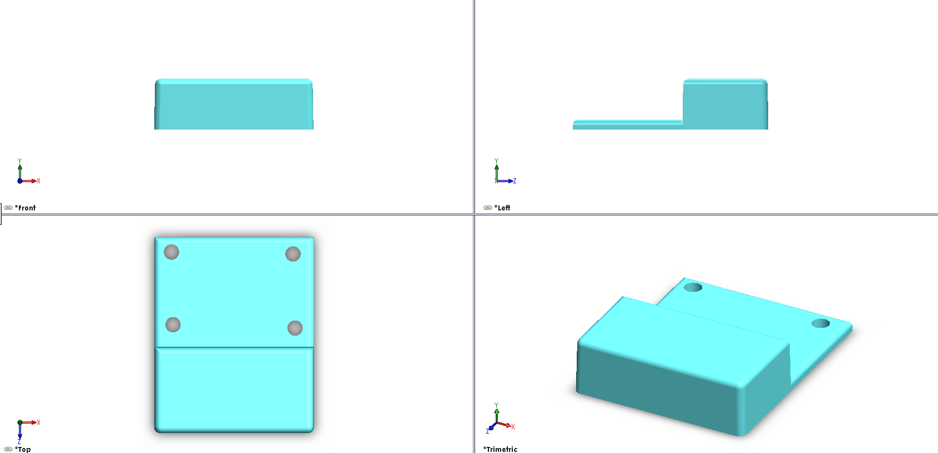
Initial Holster Design

Slide 36
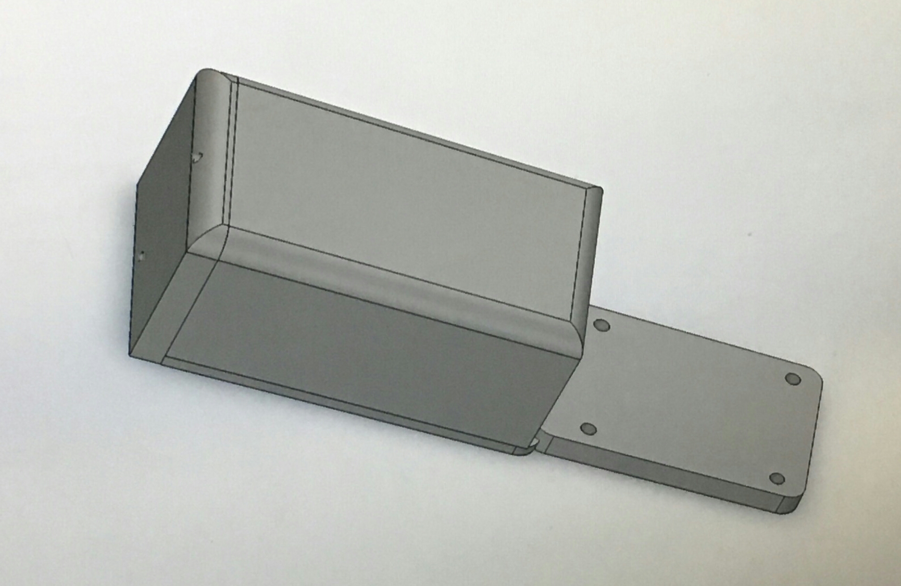
Final Holster Design

Slide 37
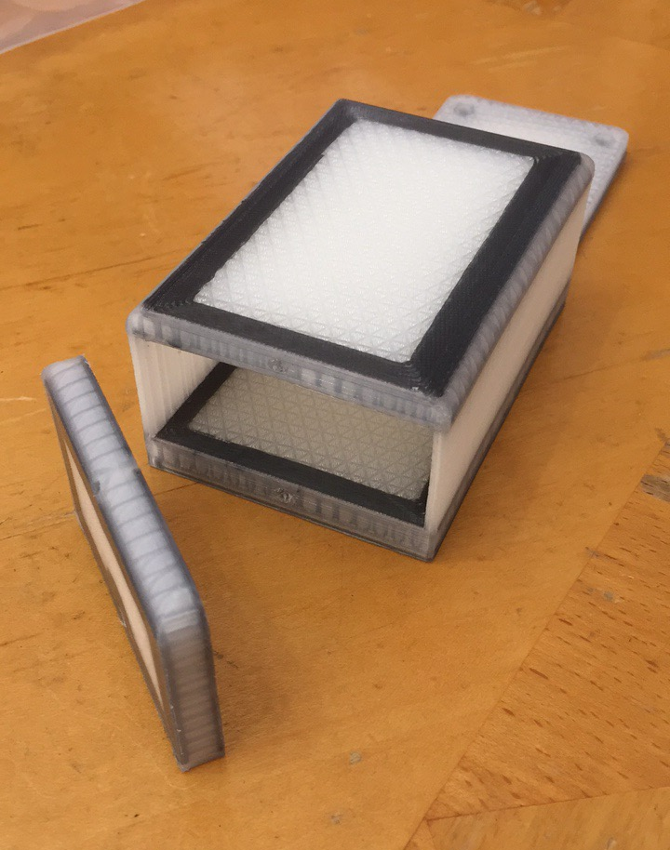
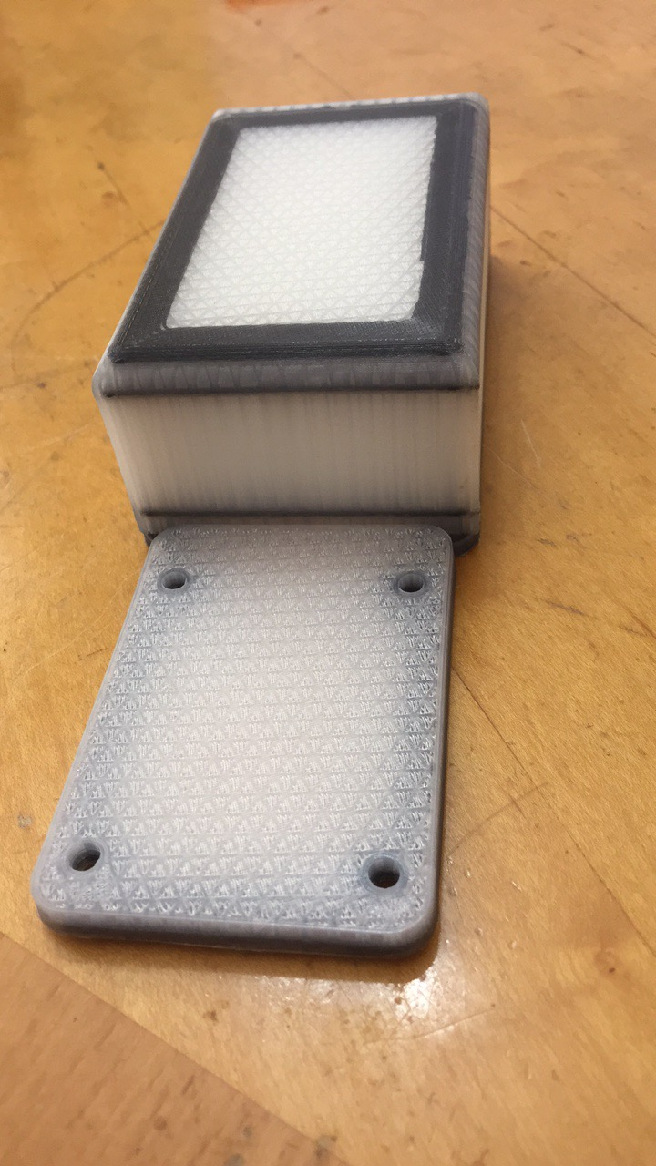
Final Holster Prototype
Notes:
Fiber-Reinforced Nylon (strong as aluminum, cheap as plastic)

Slide 38
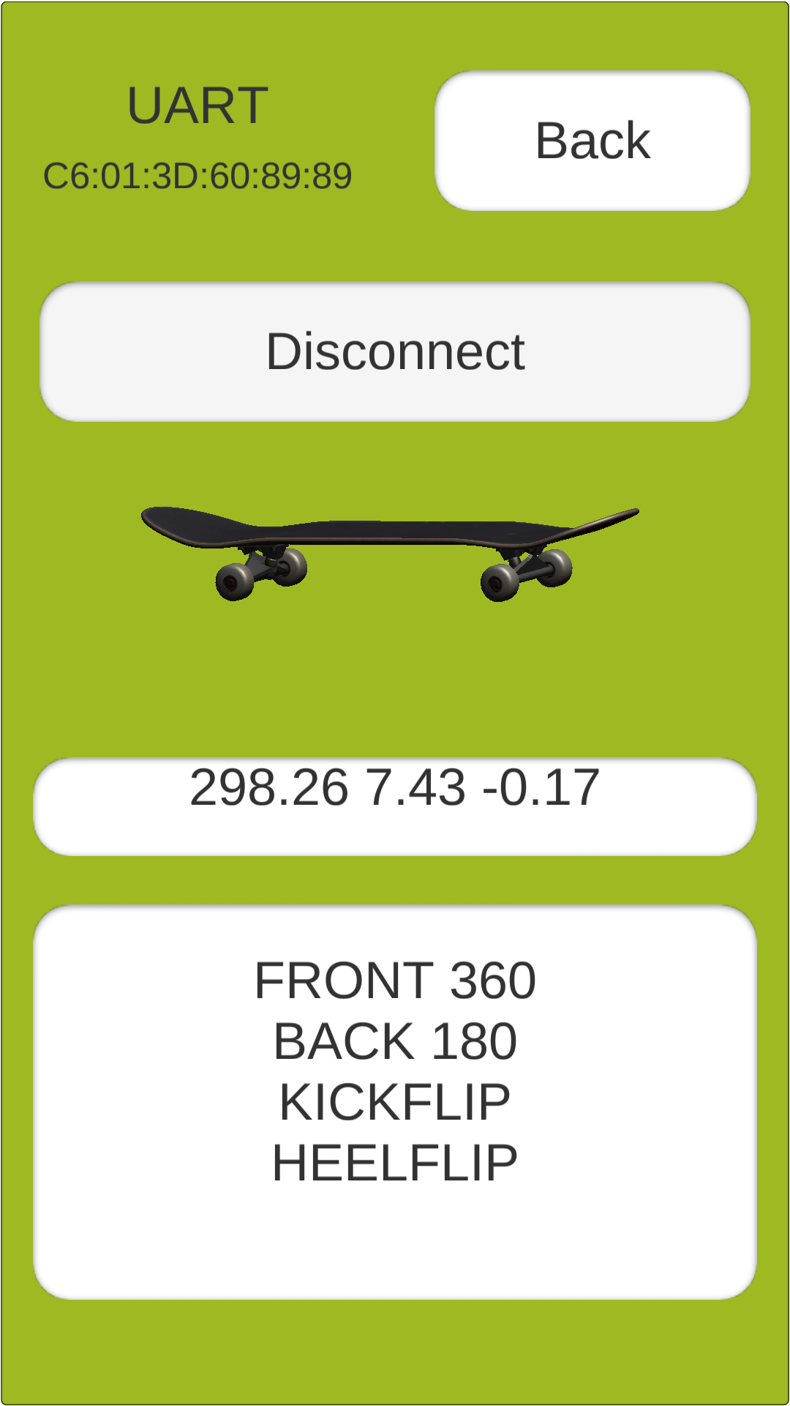
Mobile Application
3D model follows skateboard rotation
Heading, roll, pitch
Last 6 tricks detected

Slide 39
Software Development Environment
Unity:
3-D Game Engine Included
Easy to implement cross-platform compatibility
Scripting in C#

Slide 40
ANTICIPATED BUDGET
COMPONENT | PRICE
Processor/Microcontroller | $25.00
Accelerometer | $10.00
Gyroscope | $9.95
Barometer | $8.50
Battery | $12.95
Wireless Communication | $22.00
PCB Manufacturing | $60.00
Holster | $25.00
Miscellaneous | $35.00
Total Cost | $208.40

Slide 41
UP TO DATE BUDGET
Arduino Uno | $25.95
nRF8001 Bluetooth LE | $19.95
Gyroscope, Accelerometer & barometer | $29.95
Resistors/Capacitors | $5.00
PCB Manufacturing + Shipping | $41.60
Holster Manufacturing + Shipping | $82.52
Total | $204.97

Slide 42
Possible Future Upgrades
1.) Create a point system for each trick.
2.) Track more stats about each trick.
3.) Develop algorithm for more complex tricks.
4.) Add a social timeline feature to the mobile application.
5.) Create a device for other sports (i.e. snowboarding, bmx, football, etc.)
6.) Make multiple devices link up to allow for competition.

Slide 43
Challenges
Creating a final holster design to 3D print
Creating the software to decipher each trick
Optimal PCB design
Keeping the error rate of the sensors under 10%
Keeping latency as low as possible (under 5 seconds)
Notes:
Lacking cad experience
Real-time results; keep the error rate of the sensors under 10%
delay between a completed trick and the display on the device be a maximum of 5 seconds

Slide 44
Division of Labor
Group Member | PCB and Sensor Design | Mobile App | Power Supply | Holster Design
Brandon | Primary |  | Secondary | Secondary
John | Primary | Secondary |  | Secondary
Nick | Secondary |  | Primary | Primary
Taymas | Secondary | Primary

Slide 45
Video Demonstration

